Slide 1
.NET Standard
Damien Bowden January 2018

Slide 2
Agenda
1
What is .NET Standard
2
Where can you use it
3
Demo

Slide 3
What is .NET Standard

Slide 4
.NET Standard is a
specification of .NET APIs
which can be implemented.

Slide 5
.NET Framework, Xamarin and
.NET Core are implementations
of .NET Standard

Slide 6
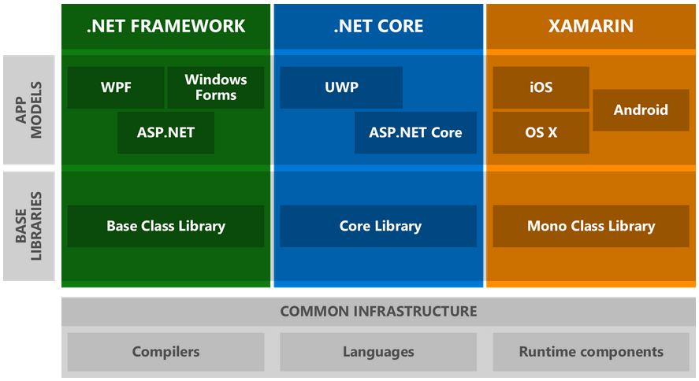

Slide 7
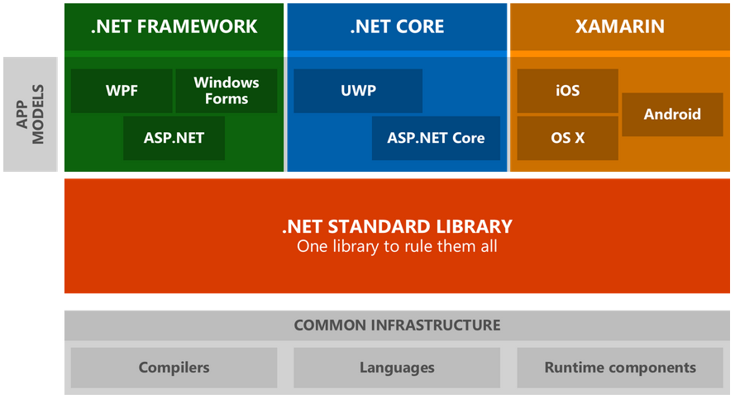

Slide 8
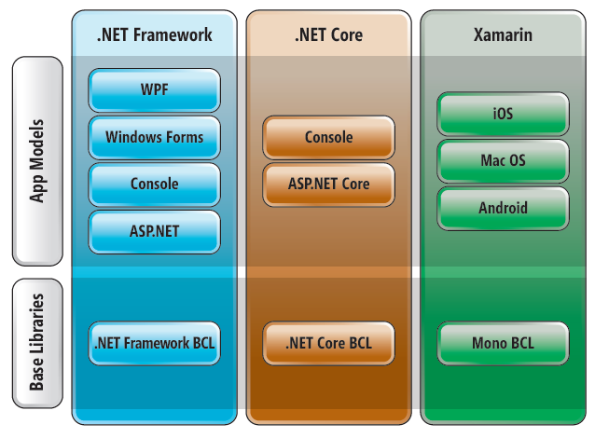

Slide 9
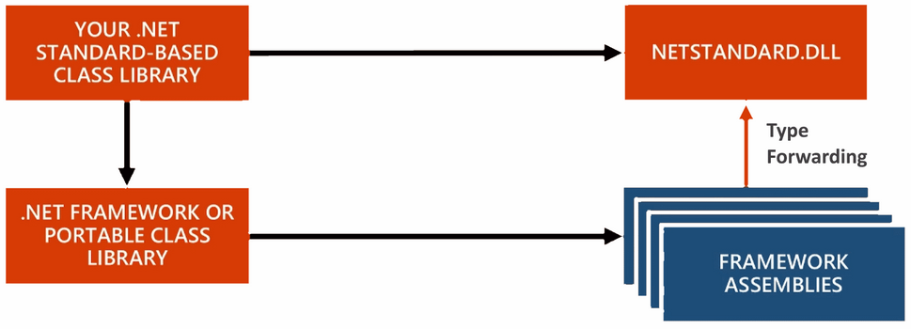

Slide 10
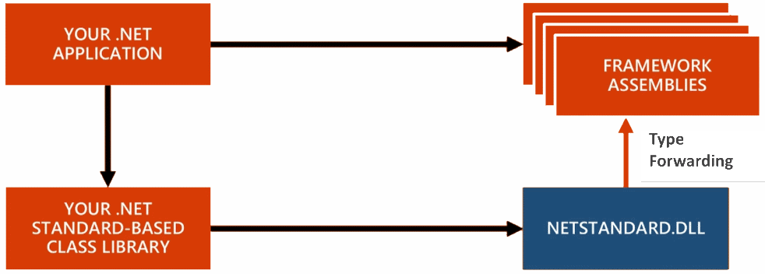

Slide 11
Where can you use it

Slide 12
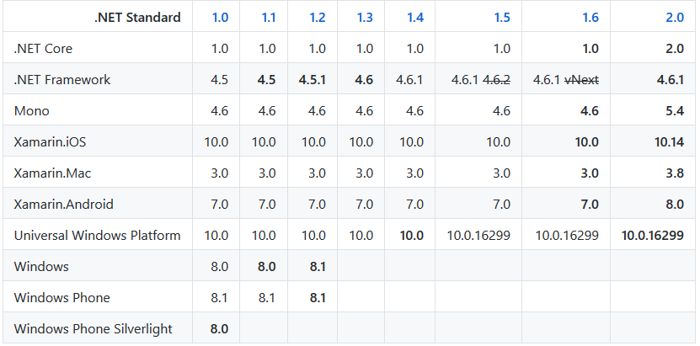

Slide 13
Demo

Slide 14
Development
Visual Studio 2017
Visual Studio Code
Visual Studio for Mac

Slide 15
Damien Bowden
Damien.bowden@noser.com

Slide 16
Sources
https://docs.microsoft.com/en-us/dotnet/standard/net-standard
https://msdn.microsoft.com/en-us/magazine/mt842506.aspx
https://github.com/dotnet/standard/blob/master/docs/versions.md
https://github.com/dotnet/standard/blob/master/docs/faq.md

